Slide 1
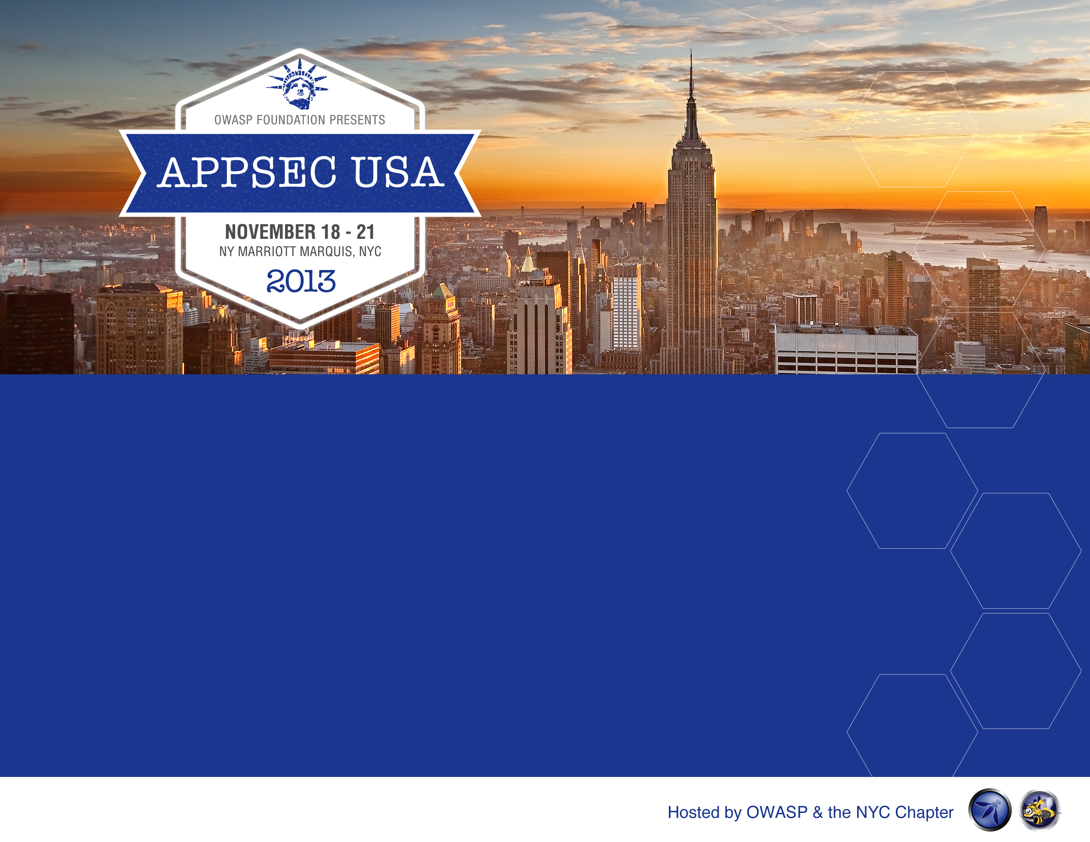
Automation Domination
Application Security with Continuous Integration (CI)

Slide 2
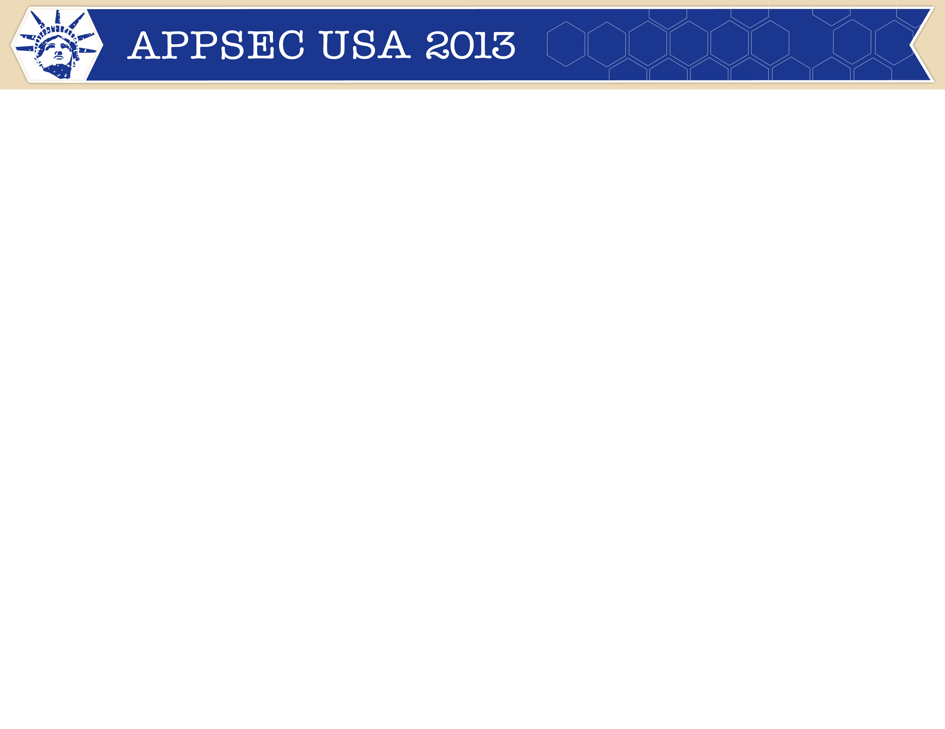


About Me
Lead Application Security Engineer for Morningstar formerly with CME Group
Over 8 years of leading and participating in all aspects of the Security Development Lifecycle (SDL), including developing, deploying, supporting enterprise static (SAST) and dynamic scanners (DAST).
Hosted by OWASP & the NYC Chapter

Slide 3
Agenda
Why bother
Zero-sum game for application security
Where to start?
Tipping the scales in our direction
Making it work for you!
Demo
Hosted by OWASP & the NYC Chapter

Slide 4
Automation Domination
Should I pay attention?
Are you a current, future, or past Dynamic and/or Static Scanner users?
Are you looking to implement a Security Development Lifecycle (SDL) or Software Development Lifecycle (SDLC) ?
Interested in saving time and money to deliver software?
Is management bugging you about metrics?

Slide 5

Automation Domination
Mission
Develop an application security automation program to assist software development teams with iterative application security testing.
Hosted by OWASP & the NYC Chapter

Slide 6

Automation Domination
Are we outnumbered?
Hundreds to thousands of developers
Too many applications with systemic issues
Hosted by OWASP & the NYC Chapter

Slide 7
Automation Domination
Capability Maturity Model
Unpredictable
Reactive
Development Methodology
Measured & Controlled
Focus is on improvement
Hosted by OWASP & the NYC Chapter

Slide 8
Automation Domination
Software development maturity
Development
Architecture/Design Documents
Build Process & Deployment
Bug-Tracking
Architecture/Design
Data-flow diagrams (DFDs)
Charters and/or Project Plans
Hosted by OWASP & the NYC Chapter

Slide 9
Automation Domination
Normalize your scans & findings
Findings
Taxonomy of Findings/Vulnerabilities (CWE)
Risk Scoring (CVSS)
Anatomy of Findings/Vulnerabilities (Issue Type)
Scanning
Scope your DAST & SAST findings to Development
Define a process from finding-to-fix

Slide 10
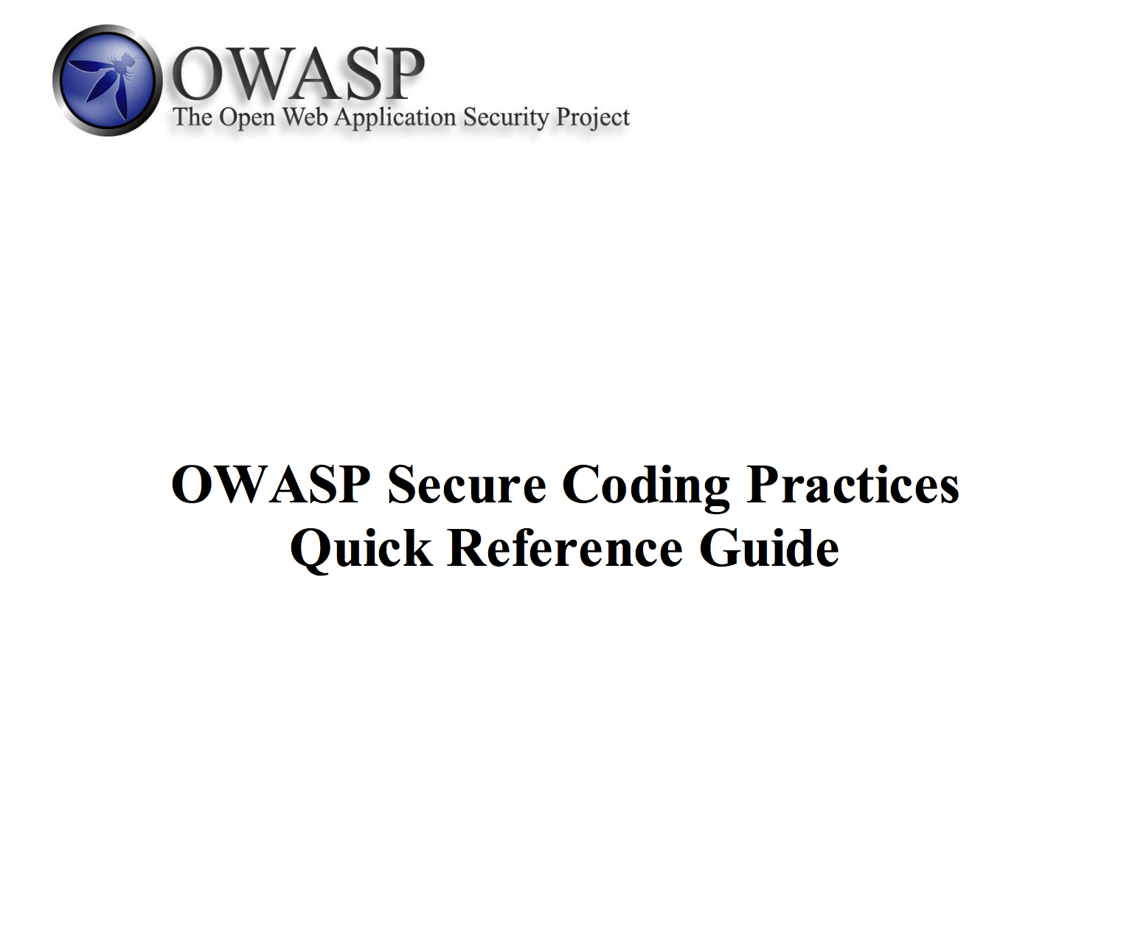
Automation Domination
OWASP has the technology!

Slide 11
Automation Domination
Topics for Requirements
Authentication
Session Management
Authorization
Input Validation
Output Encoding
Client Side Security
Sensitive Data Handling
Data Protection (Data in Transit & Rest)
Supplemental Specifications for Testing
Hosted by OWASP & the NYC Chapter

Slide 12
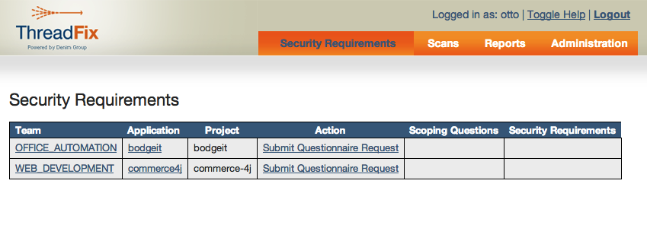
Automation Domination
ThreadFix (Security Requirements)

Slide 13
Automation Domination
Network Topology
Hosted by OWASP & the NYC Chapter

Slide 14
Automation Domination
Working the flow
Hosted by OWASP & the NYC Chapter

Slide 15
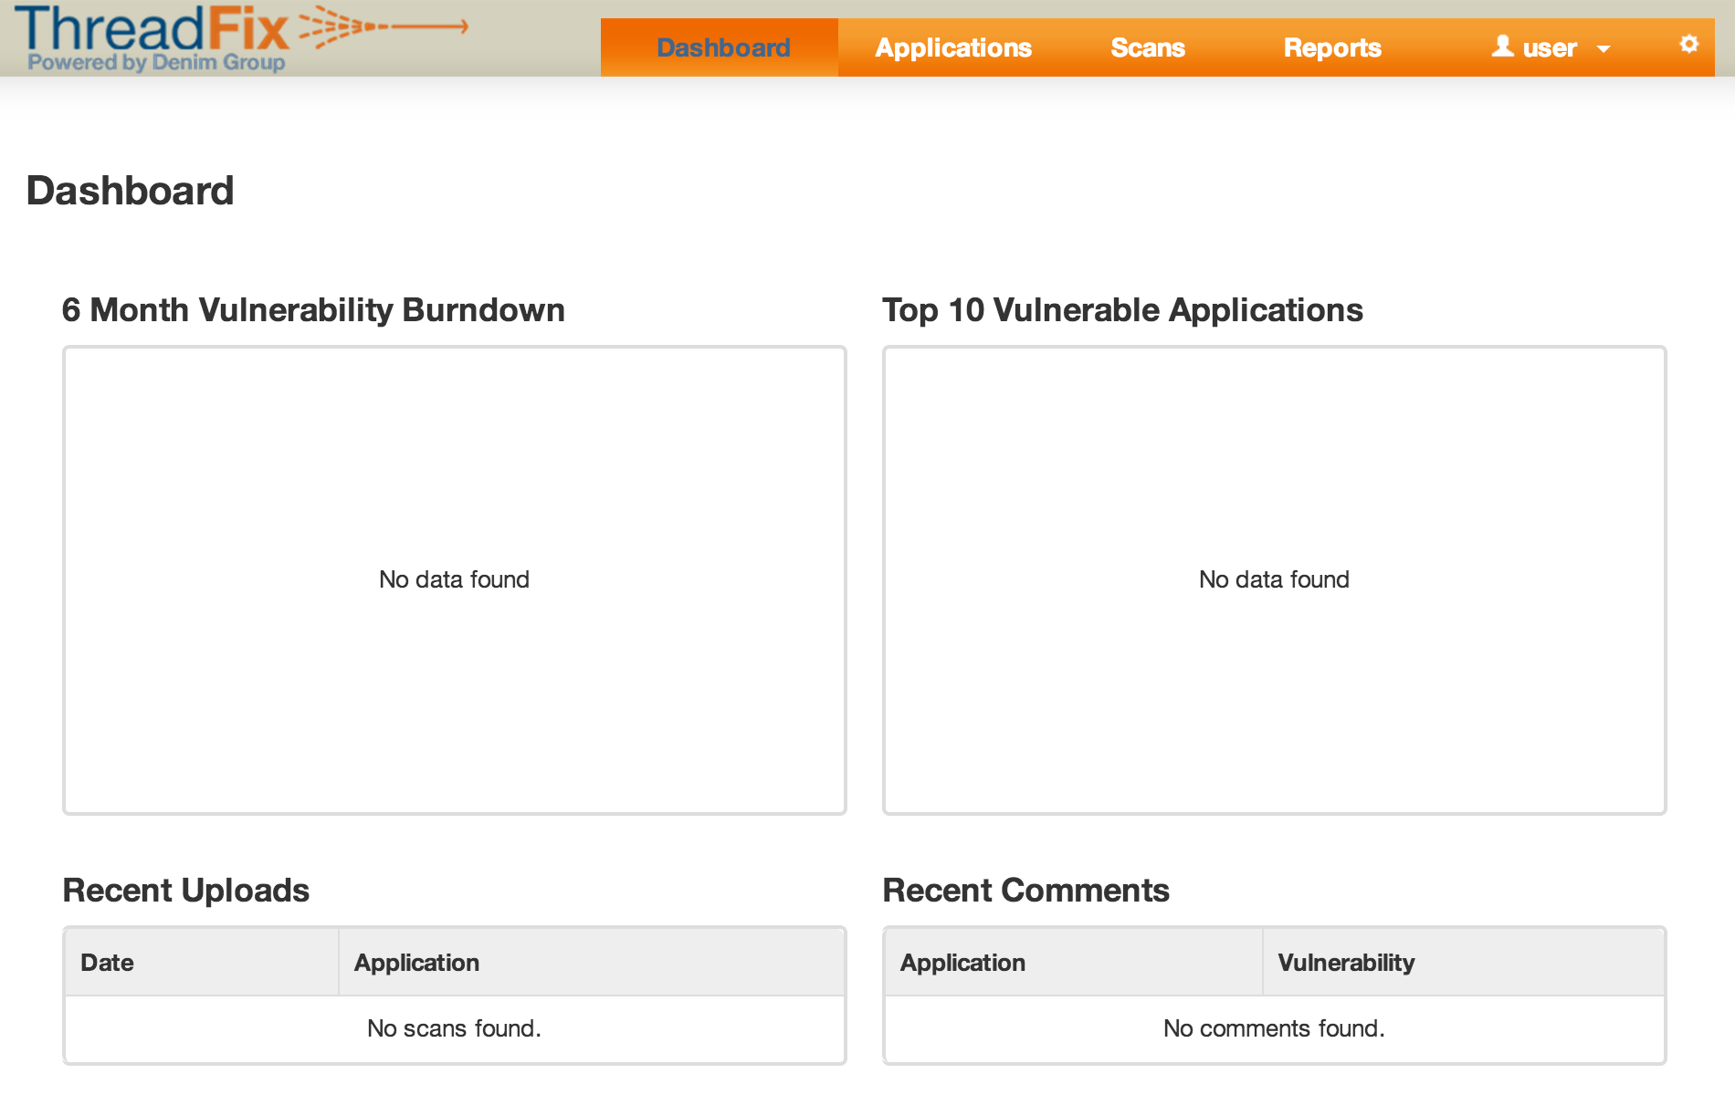
Automation Domination
ThreadFix Configuration

Slide 16
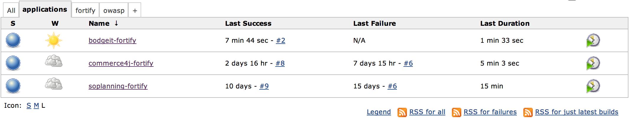
Automation Domination
Automated Static Analysis

Slide 17
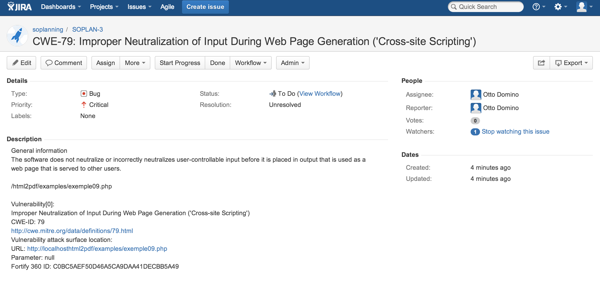
Automation Domination
Bug Submission

Slide 18
Automation Domination
Now for a change of pace!

Slide 19
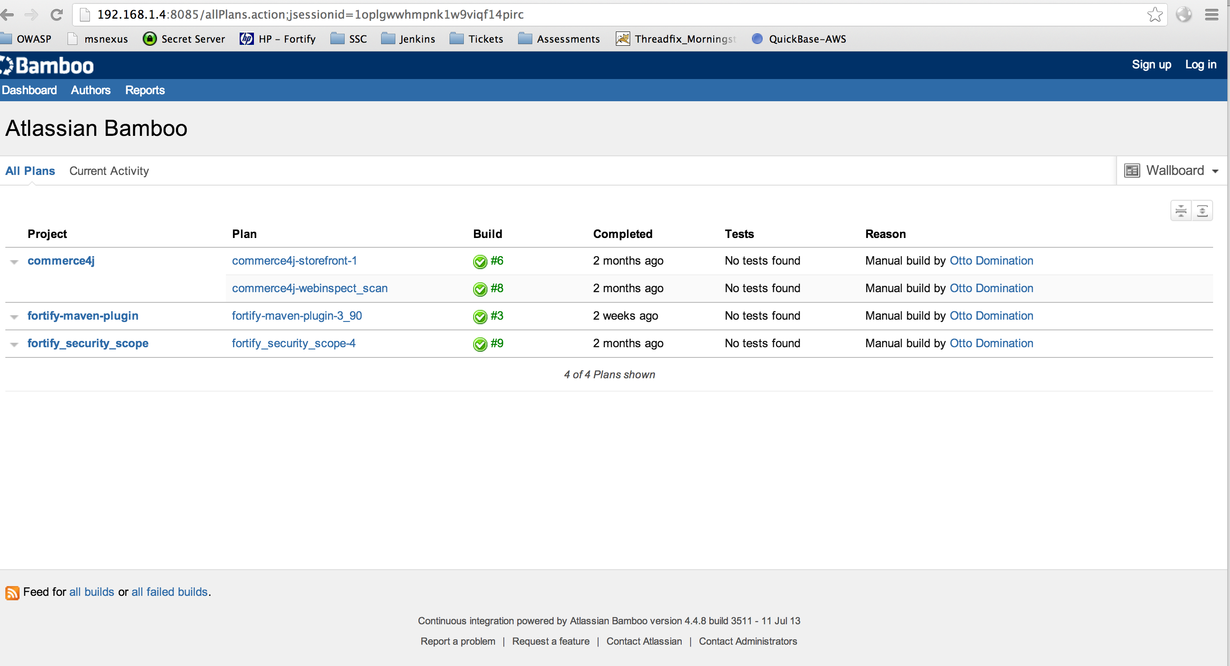
Automation Domination
Static & Dynamic Scanning w/ Bamboo

Slide 20
Automation Domination
Static & Dynamic Scanning w/ Bamboo

Slide 21
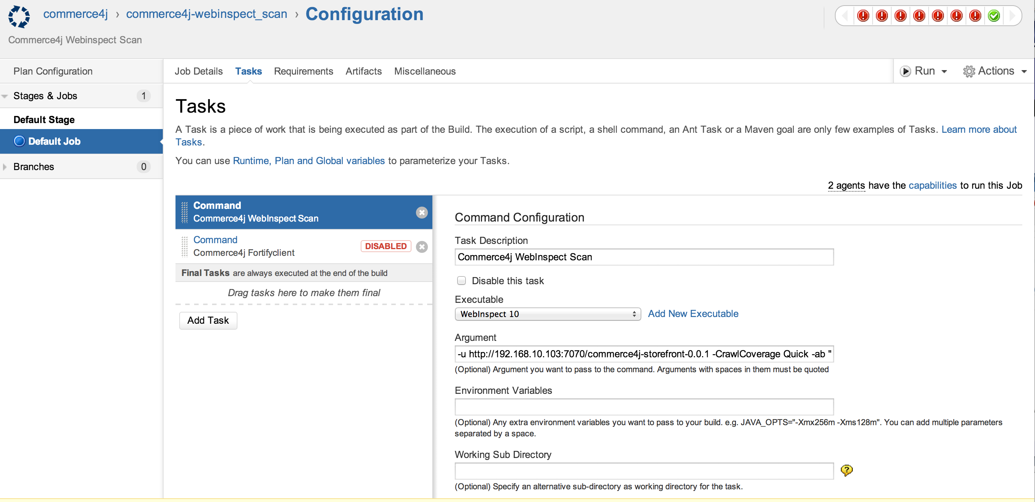
Automation Domination
Dynamic Scan in CI with Agent

Slide 22
Automation Domination
Thank you!
http://github.com/automationdomination
brandon@automationdomination.me

